Slide 1
Your OSET Electric Bikes Activity Pack
Loads of ideas and activities to help keep you busy and having fun

Slide 2
OSET Home School Challenge
 |  |  | Lesson 1 Tutorial on how to stand on the bike correctly with finger placement on levers as well as feet on pegs. We will also go through turn techniques in this video. | Challenge 1 Balance is essential. Using the tutorial, try to stay balanced on your OSET for as long as possible! | Lesson 2 Wheelies. Slow, fast or anything in-between. Watch the tutorial and then try yourself. There are many variations to try, which will be the following days challenges. | Challenge 2 Slow wheelies: See how slowly you can ride on the rear wheel!
Challenge 3 Wheelie into a wall and try to see how long you can balance on the wall for. Oliver’s record is X and Elliot’s is X | Lesson 3 Stoppies. With lots of variations, watch the tutorial to see how to do each one correctly. | Challenge 4 Stoppies off of things. Watch the stoppie tutorial to find out more! | Reaction! Reaction time! Oliver and Elliot will sit down and go through your submissions and give tips on how to improve! | Lesson 4 Bike setup: After the first challenges, we will go through bike setup for Trials. Once you have made the changes to your bike, go back and try previous challenges. | Challenge 5 Design your own riding top. You can get a blank template from the OSET site to use. Remember to send it in to us and post on social. | Practice Practice anything that you feel needs more work or a continuation of something else.
Leeson 5 Bunny Hops: How to get the most lift for obstacles. Challenge yourself to go higher with bricks or other obstacles. Watch the tutorial to learn more! | Challenge 6 #cooltrick Heelclicker stoppie challenge. Watch Elliot take on the challenge and how to complete it! | Lesson 6 Steps: The fun one! How to get up steps in a variety of ways. Find out which techniques in the tutorials. | Lesson 7 How to exaggerate your body movements to trick your body into doing it naturally. | Reaction! Reaction time! Oliver and Elliot will sit down and go through your submissions and give tips on how to improve! | Challenge 7 Balance beam challenge! Set up something thin (plank of wood) and try to ride along it, stop, balance and ride off again. | Challenge 8 #cooltrick Do as tight of a turn as you can with both legs one side of the bike. Watch the tutorial to find out how!
Lesson 8 Back wheel hops. An advanced technique that will take a long time to learn. In the tutorial we will go through the steps we took to learn them. | Practice Practice anything that you feel needs more work or a continuation of something else. | Challenge 9 Spend the day on another type of bike. Whether that be MTBs, Trials Bicycle, Unicycle or BMX, it’s all good learning! | Practice Practice anything that you feel needs more work or a continuation of something else. | Challenge 10 Challenge time. Try to stoppie and land your rear wheel on a small object like a brick. | Challenge 11 Pallet challenge. With a single pallet, try to turn the bike 360 degrees using hopping. This can also be done in a small circle. | Reaction! Reaction time! Oliver and Elliot will sit down and go through your submissions and give tips on how to improve!
Practice Practice anything that you feel needs more work or a continuation of something else. | Challenge 12 Try to do all of the past challenges in a row. Send a picture or video of your completed sheet to us! | Challenge 13 Design your own bike stickers. You can get a blank template from the OSET site to use. Remember to send it in to us and post on social | Practice Practice anything that you feel needs more work or a continuation of something else. | Challenge 14 The ultimate challenge! Try to learn how to roll back on the front wheel. Watch the tutorial and then keep trying. This one will take a lot of trying and crashing; but at the end it will be worth it! First person (under 15) to complete the challenge with video evidence will receive a prize!
The OSET challenge is designed to help you be a better rider and have fun while doing it. Just follow the instructions for each day and tag your photos with #osetchallenge
What was your favourite day?

Slide 3
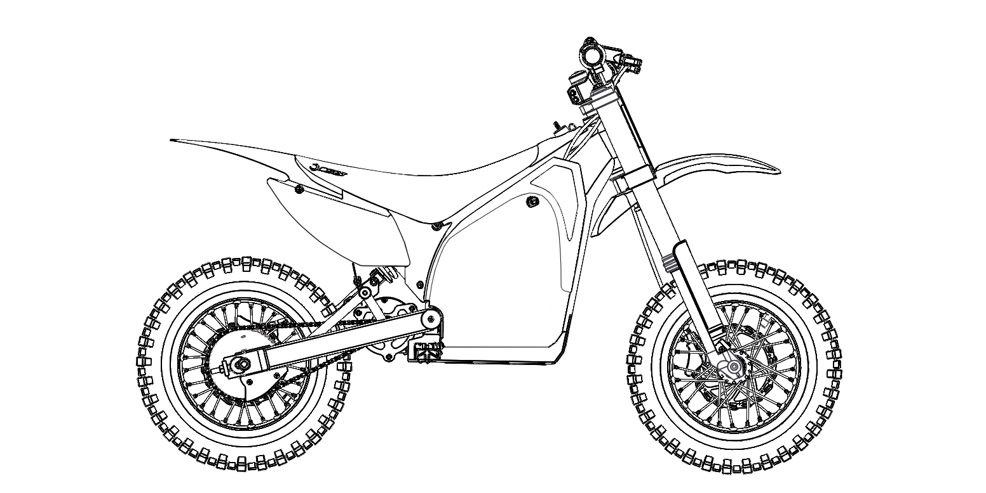
Get your pens and crayons out and design your own stickers for the MX10
#osetbikes
Make sure to copy or take a photo of your finished design and post it on the OSET Bikes Facebook page – www.facebook.com/OSETbikes/

Slide 4
OSET Bikes Easy Word Search
 |  | S |  | T |  | E |  | C |  | O |  | P |  | E |  | A |  | N |  | L |  |  | Words to find
 |  |  |  |  |  |  |  |  |  |  |  |  |  |  |  |  |  |  |  |  |  |  |  | BIKE
 |  | P |  | B |  | L |  | Y |  | R |  | D |  | O |  | S |  | E |  | T |  |  |  | OSET
 |  |  |  |  |  |  |  |  |  |  |  |  |  |  |  |  |  |  |  |  |  |  |  | TYRE
 |  | O |  | L |  | I |  | T |  | A |  | T |  | X |  | I |  | Z |  | Y |  |  |  | FUN
 |  |  |  |  |  |  |  |  |  |  |  |  |  |  |  |  |  |  |  |  |  |  |  | MUD
 |  | L |  | I |  | H |  | K |  | C |  | O |  | L |  | M |  | B |  | R |  |  |  | ELECTRIC
 |  |  |  |  |  |  |  |  |  |  |  |  |  |  |  |  |  |  |  |  |  |  |  | RACE
 |  | N |  | F |  | P |  | T |  | E |  | M |  | A |  | C |  | O |  | E |  |  |  | TRIAL
 |  |  |  |  |  |  |  |  |  |  |  |  |  |  |  |  |  |  |  |  |  |  |  | ECO
 |  | M |  | U |  | D |  | T |  | L |  | Q |  | I |  | S |  | T |  | D
 |  | R |  | N |  | A |  | F |  | D |  | U |  | R |  | E |  | H |  | F
 |  | C |  | T |  | E |  | L |  | E |  | C |  | T |  | R |  | I |  | C
 |  | A |  | P |  | M |  | R |  | Q |  | P |  | F |  | G |  | L |  | N
Can you find all the hidden words from the table above? There are also some bonus words to find!

Slide 5
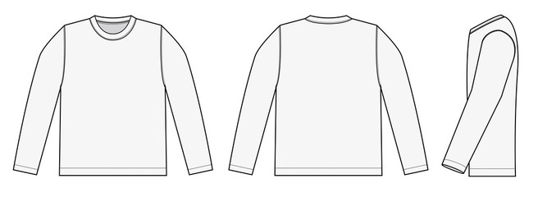
Design your own riding jersey
Get your pens, pencils and crayons out and design your very own OSET riding jersey
#osetbikes
Front
Back
Side
Make sure to copy or take a photo of your finished design and post it on the OSET Bikes Facebook page www.facebook.com/OSETbikes/ and tag with #osetactive

Slide 6
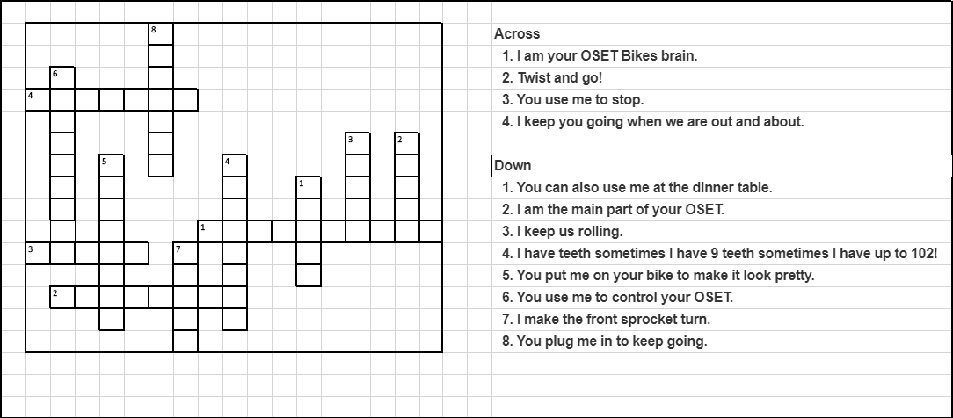
OSET Bikes Crossword Puzzle
Can you solve the clues to find the words?
All answers at www.osetbikes.com/activitypack

Slide 7
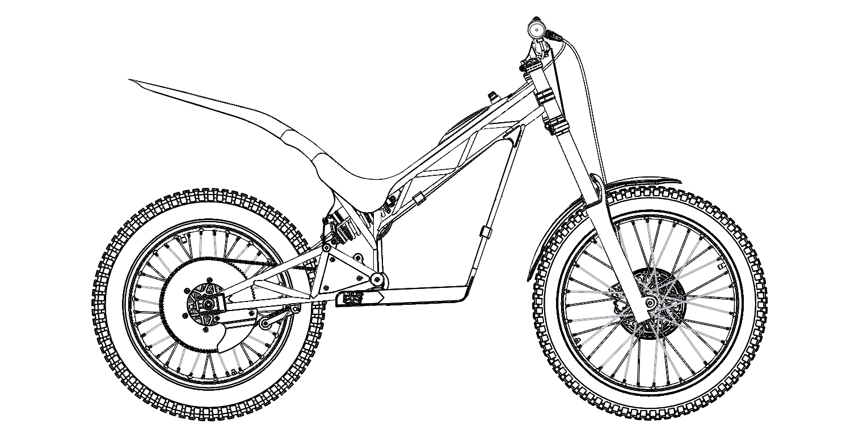
Get your pens and crayons out and design your own stickers for the 24.0 Racing
#osetbikes
Make sure to copy or take a photo of your finished design and post it on the OSET Bikes Facebook page – www.facebook.com/OSETbikes/

Slide 8
Your OSET Bikes Adventure
Write your perfect OSET adventure story! We will get you started and you fill in the rest, tell us where you go, who you are with and what you get up to! Maybe you want to practice some new tricks or you are competing in an event…whatever it is, have fun and let your imagination go wild!
You wake up early and it’s a beautiful morning, its sunny and warm and you have the whole day free to have an OSET adventure. Your bike is super clean and fully charged. You put your riding gear on remembering your gloves, boots and helmet and head downstairs…..

Slide 9
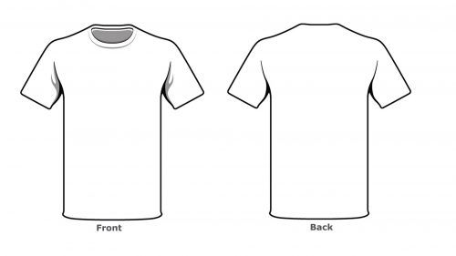
Design your own T-shirt
Get your pens and crayons out and design your very own OSET T-shirt!
#osetbikes
Make sure to copy or take a photo of your finished design and post it on the OSET Bikes Facebook page www.facebook.com/OSETbikes/ and tag with #osetactive

Slide 10
OSET Bikes Electric Quiz
HINT … All answers to the quiz can be found somewhere either on our website or in our magazine!!
11. Who are our most northerly and southerly importers?
12. What are the two types of batteries that we use in our bikes?
13. Name 3 famous enduro riders who started in Trials.
14. How many different voltages of bike do we have? What are they?
15. How many different designs of OSET casual t-shirts are there?
16. How many British championship titles have riders on OSET bikes won?
17. What is the name of the famous trial held in Scotland every year?
18. How many times has Elliot Smith (OSET Bikes founders’ youngest son!) won the UK National Trials Championship?
19. How many parts categories are listed on our website?
20. What does OSET take seriously?
1. What does OSET stand for?
2.How many sizes of OSET bikes are there?
3. When was OSET Bikes founded?
4. What age can you compete at an OSET Cup from?
5. What’s the name of the motorcycle governing body?
6. How many countries is OSET Bikes now present in?
7. What’s our membership club called?
8. What year was the very first OSET made?
9. What is our magazine called?
What rider has won 27 Trials World Titles?
Answers can be found here: www.osetbikes.com/activitypack

Slide 11
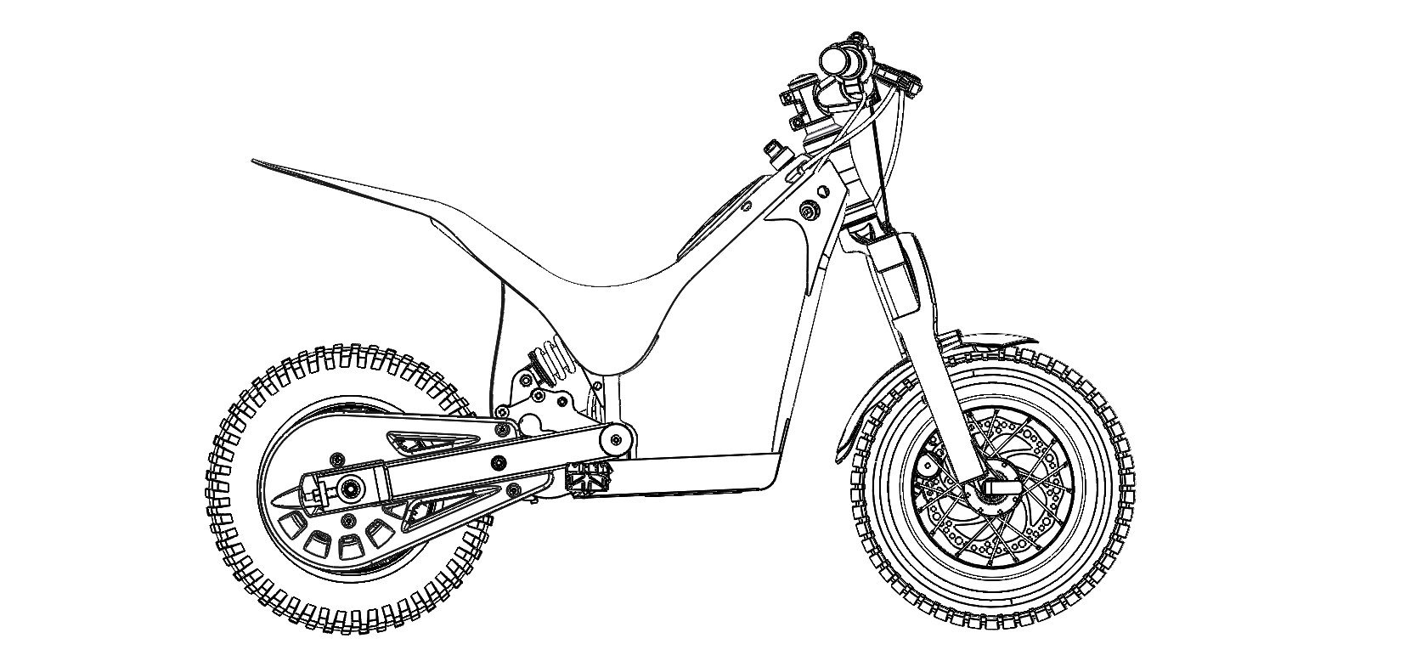
Get your pens and crayons out and design your own stickers for the 12.5 Racing
#osetbikes
Make sure to copy or take a photo of your finished design and post it on the OSET Bikes Facebook page – www.facebook.com/OSETbikes/

Slide 12
OSET Bikes Difficult Word Search
 | E | C | O | M | P | E | T | I | T | I | O | N | L | E | S | Z | M | P | A | N |  |  | 1 | OSET
 | T | O | S | R | D | K | B | E | Y | F | S | C | A | M | T | O | P | S | D | I |  |  | 2 | ECO
 | D | E | Q | A | P | O | U | S | E | L | M | T | D | O | N | E | I | P | C | L |  |  | 3 | RACING
 | N | F | O | S | E | T | H | W | A | Y | A | H | K | T | A | Q | R | O | M | Q |  |  | 4 | BIKES
 | Y | H | S | Z | M | L | K | I | L | F | U | H | S | O | Z | B | A | I | S | R |  |  | 5 | TRIALS
 | O | J | T | O | P | Y | R | B | Q | S | Z | M | M | R | O | U | C | E | P | Y |  |  | 6 | ELECTRIC
 | Q | C | N | E | I | T | E | U | S | T | O | P | I | C | E | L | I | F | U | P |  |  | 7 | OFFROAD
 | A | N | O | S | Z | M | S | Y | L | N | E | I | L | Y | S | D | N | H | C | Z |  |  | 8 | LITHIUM
 | D | I | F | T | O | P | P | M | U | D | A | E | E | C | T | K | G | A | T | O |  |  | 9 | MOTORCYCLES
 | C | L | F | N | E | I | O | H | A | P | P | Y | M | L | N | S | P | N | E | E |  |  | 10 | QUIET
 | M | Q | R | A | P | D | I | X | C | T | O | Q | S | E | A | N | S | D | S | S |  |  | 11 | MUD
 | S | A | O | Y | E | L | I | T | H | I | U | M | P | S | D | I | P | C | O | T |  |  | 12 | OSETCUPS
 | T | I | A | F | B | H | K | D | U | Y | M | H | O | Y | C | L | O | M | R | N |  |  | 13 | COMPETITION
 | O | H | D | C | M | R | E | D | E | L | A | N | I | B | M | Q | P | U | B | A |  |  | 14 | ACU
 | P | P | O | B | W | A | C | U | S | J | D | I | E | L | E | C | T | R | I | C |  |  | 15 | RIDE
 | P | N | B | R | B | E | S | Z | M | Q | C | L | H | Y | A | H | K | F | L | O
 | I | D | S | I | U | Y | T | O | P | U | M | Q | E | H | A | S | A | E | R | P
 | E | C | P | Q | K | L | N | E | I | I | S | P | C | B | U | Y | D | S | Z | M
 | S | L | O | F | D | E | P | A | R | E | D | A | O | M | T | I | Q | T | O | P
 | Q | A | A | P | D | I | S | D | K | T | L | F | U | H | R | E | W | O | P | E
Can you find all the hidden words from the table above? There are also some bonus words to find!

Slide 13
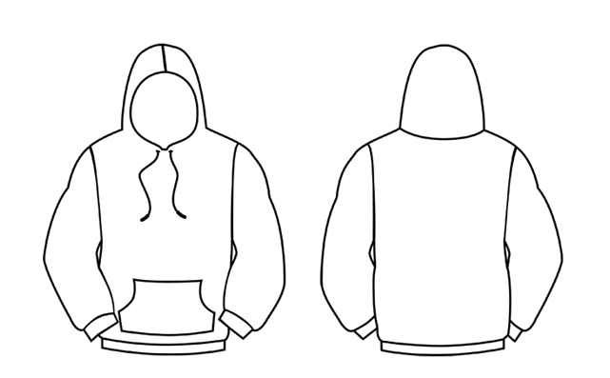
Design your own hoodie
Get your pens, pencils and crayons out and design your very own OSET hoodie
#osetbikes
Front
Back
Make sure to copy or take a photo of your finished design and post it on the OSET Bikes Facebook page www.facebook.com/OSETbikes/ and tag with #osetactive

Slide 14
Design your own riding trousers
Get your pens, pencils and crayons out and design your very own OSET riding trousers
#osetbikes
Front
Back
Side
Make sure to copy or take a photo of your finished design and post it on the OSET Bikes Facebook page www.facebook.com/OSETbikes/ and tag with #osetactive

